Slide 1
Structure Investigation of Fam20C, A Golgi Casein Kinase
Sharon Grubner
National Taiwan University
Fourth Weekly report – July 17th, 2013

Slide 2
Progress
Calculated and plotted RMSF for P-loop and 300-306 loop
Measured the distances between alpha carbons of P-loop and C-terminal lobe to measure opening and closing of the binding pocket
Completed calculations and plots for interactions between specific residues in the ATP binding pocket of FAM20C
Calculated the percentage of simulation time there are salt bridges between these residues
Learned how to use VolMap Tool in VMD
Looking at the percentage of water molecules present inside the ATP binding pocket
Clustering
Learned how to prepare pdb files of trajectory and active site for submission
Sent the active side residues for verification before sending my clustering job
My progress is being updated on a daily basis and shared with my mentors on Evernote.

Slide 6
Goals for Next Week
Qualitative analysis
Read relevant papers and learn about the process of structure and data analysis for drug discovery purposes
Watch the motion of various loops within Fam20C structure
Analysis of RMSF results
Watch trajectory and draw conclusions for drug discovery purposes
Clustering
Send my first clustering job

Slide 7
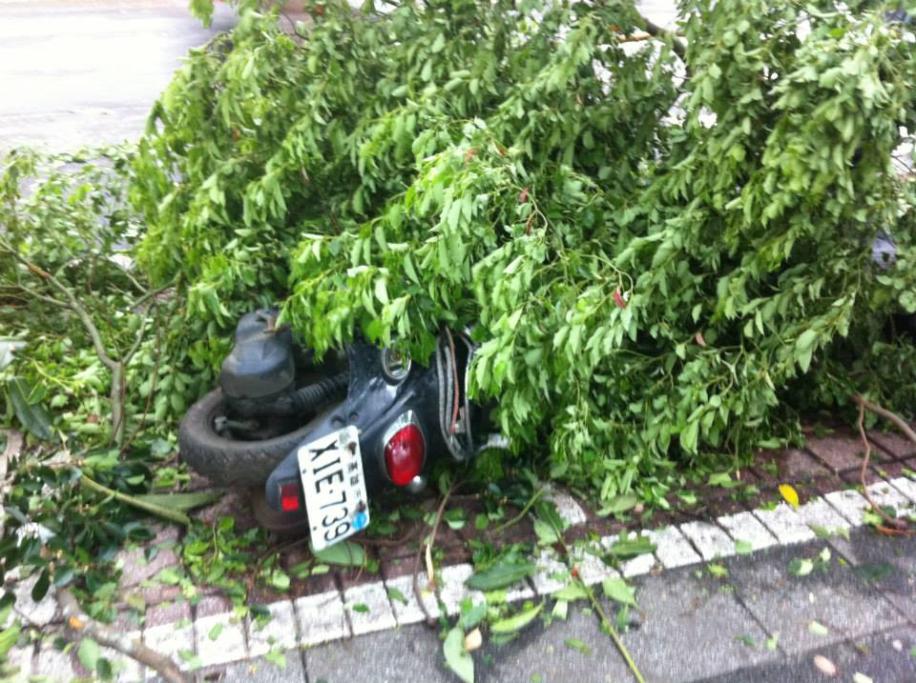
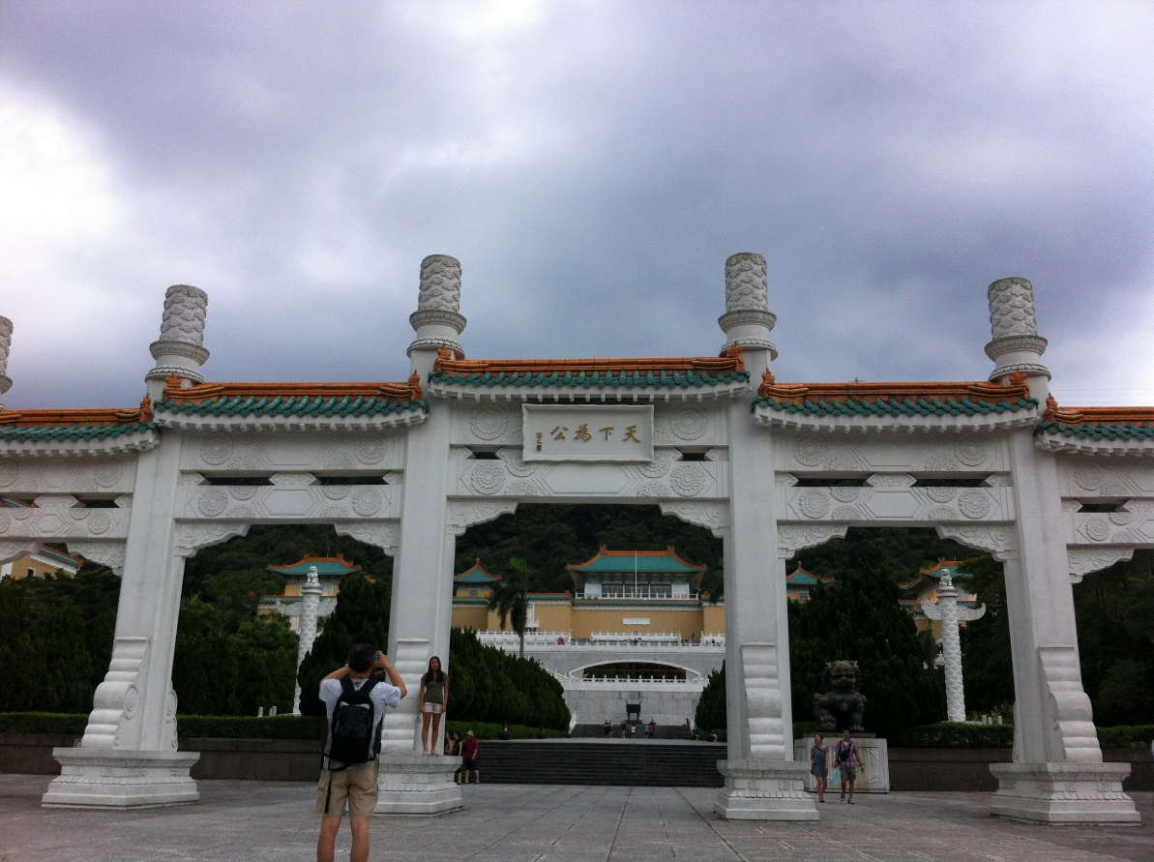
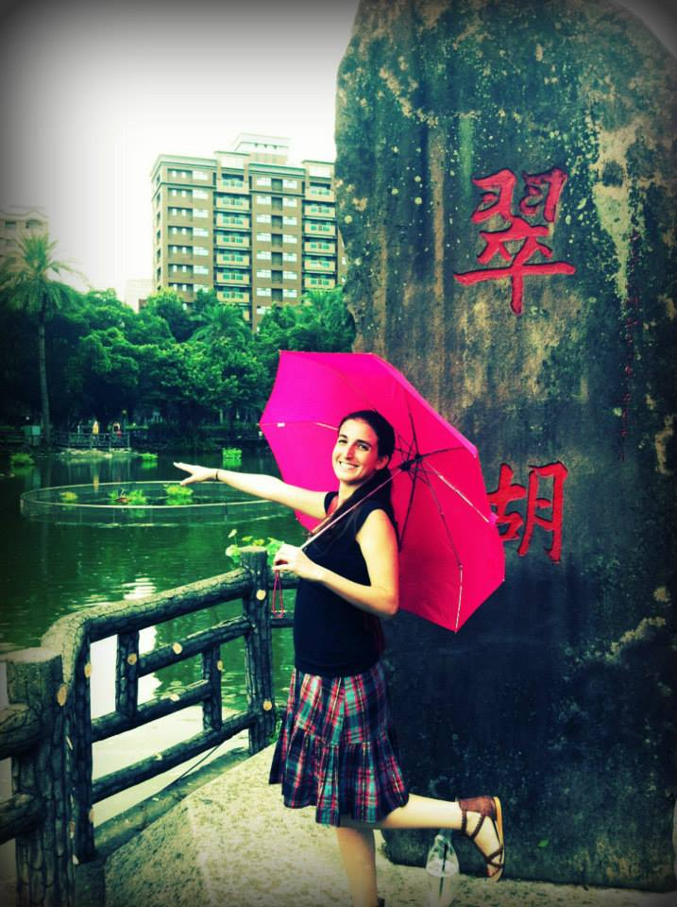
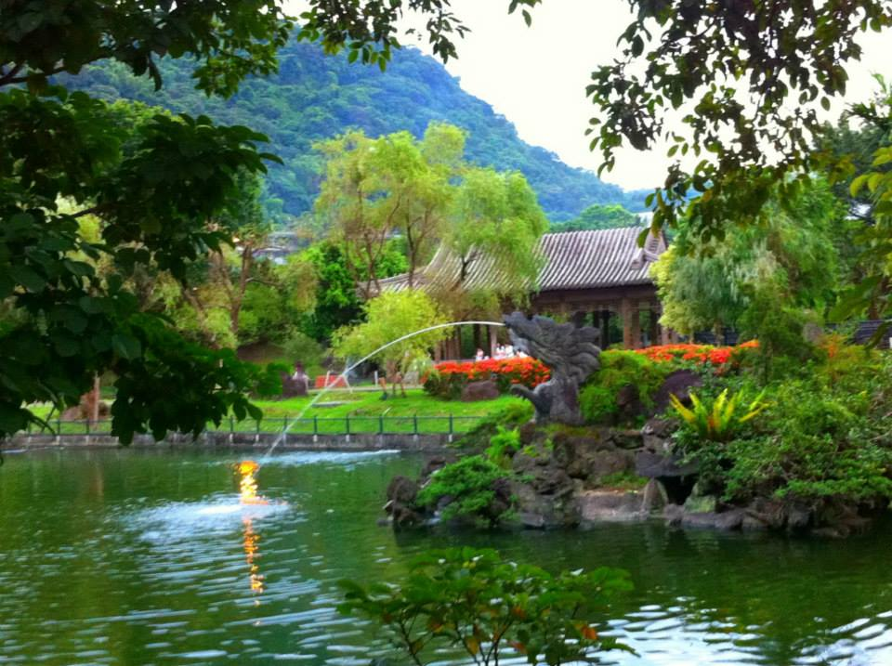
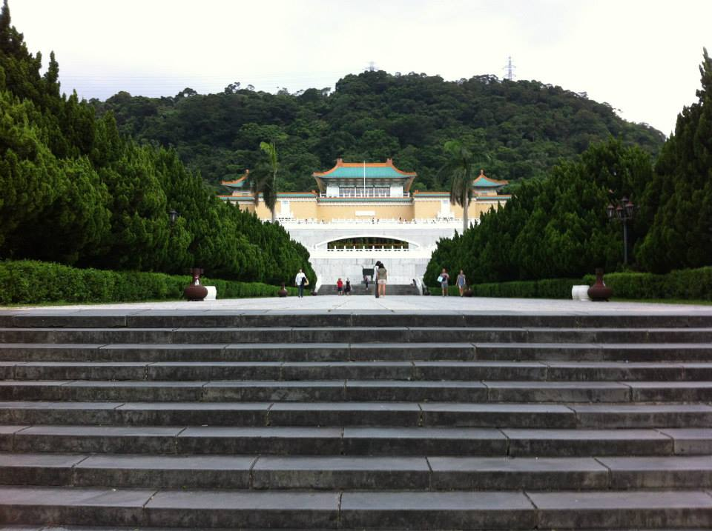
Culture
We survived a typhoon…
S.Y.S Memorial Hall
National Palace Museum

Slide 8
Acknowledgments
UCSD (University of California San Diego)
Dr. Rommie Amaro
Dr. Gabriele Wienhausen
Dr. Peter Arzberger
Teri Simas
NTU (National Taiwan University)
Dr. Jung-Hsin Lin
Julia Brown Research Scholarship

